Slide 1
RUSSIAN DEMOGRAPHICS AND POPULATION ANALYSIS
Archana R
Elena
Joe O
RK

Slide 2

Analysis: Russian population
The data contains the demographic features like:
natural population growth(npg)
birth rate
death rate
population in the respective region
corresponding year

Slide 3
Keys for the columns
“year” | Year (2010 - 2017)
“region” | name of a federal subject of Russia. It could be oblast, republic, krai, autonomous okrug, federal city and a single autonomous oblast
“npg” | natural population growth by 1000 people. Calculating as the difference between birth rate and death rate
“birth rate” | number of births by 1000 people
“death rate” | number of deaths by 1000 people
“Migratory growth” | migratory population growth by 1000 people
“population” | calculating according to last census

Slide 4

Analysis
Birth rate
Death rate
Difference between birth rate and death rate
Npg
Top 10 regions based on birth rate
Top 10 regions based on death rate
Analyze 3 cities based on npg, birth and death rates, migratory growth
Find in what regions npg is positive and in what regions is negative

Slide 5
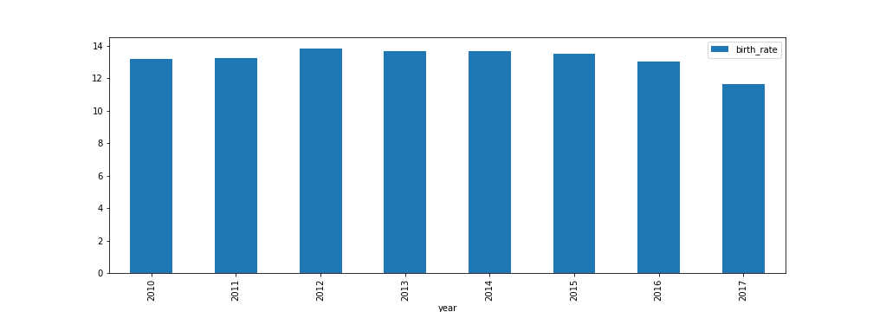
Bar plot based on year and birth rate

Slide 6
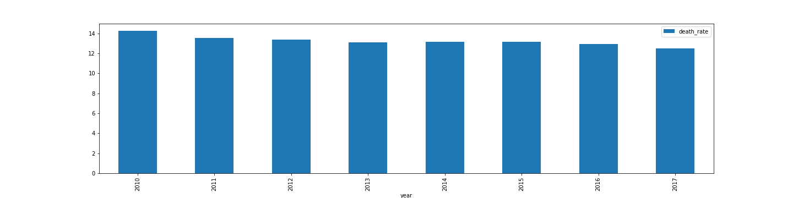
Bar plot based on region and death rate

Slide 7
the natural population growth per 1000 people (graph shows the trend of npg over the years(birth rate-death rate))

Slide 8
migratory growth

Slide 9
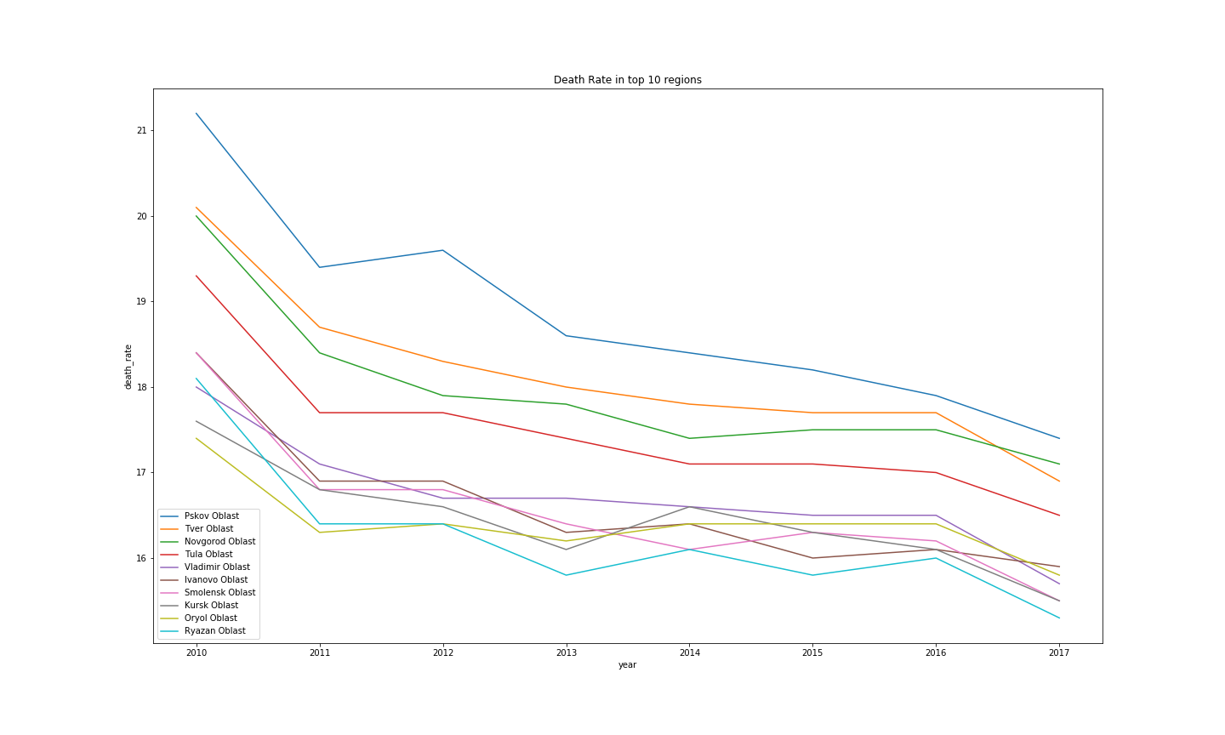
Death rate in top 10 regions

Slide 10
Moscow overall performance over years

Slide 11
Krasnoyarsk Krai overall performance over years

Slide 12
Pskov Oblast overall performance over years

Slide 13
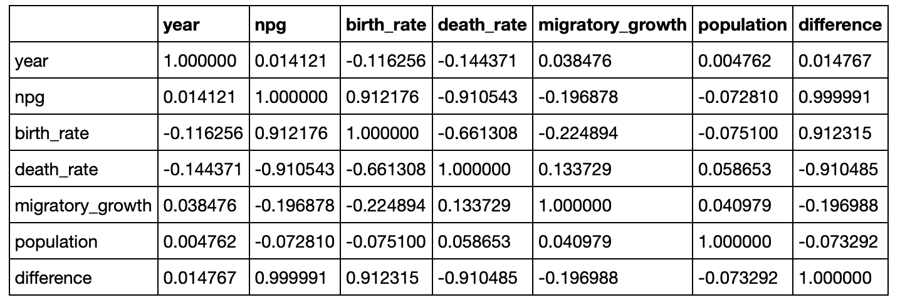
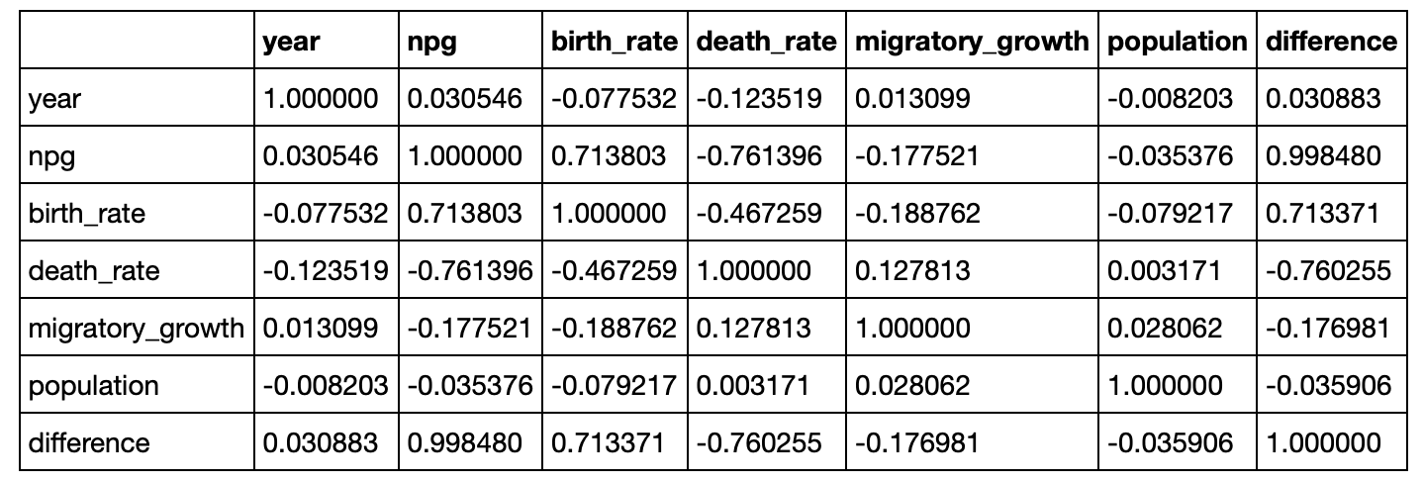
Correlation (based on two different methods)
Pearson
Kendall

Slide 14
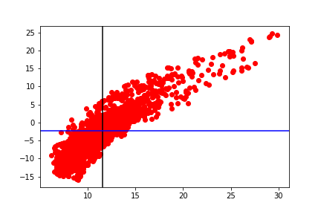
Scatter plot analysis of birth rate and npG

Slide 15
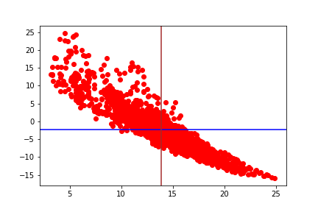
Scatter plot analysis of death rate and npg

Slide 16
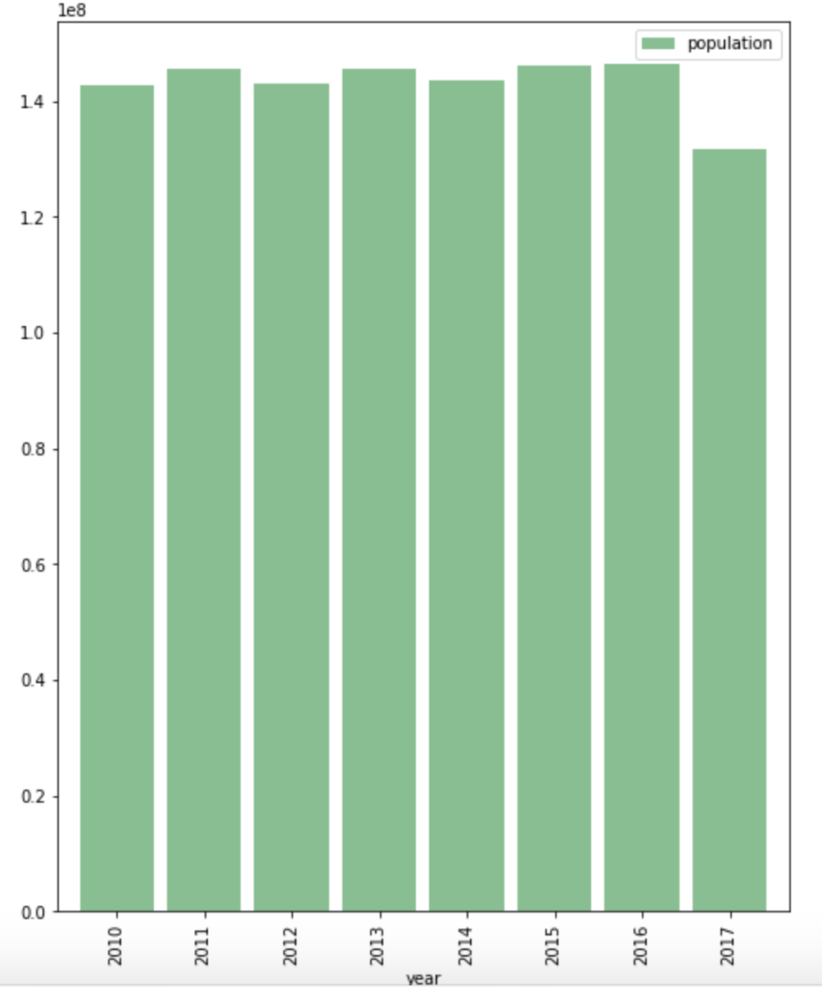
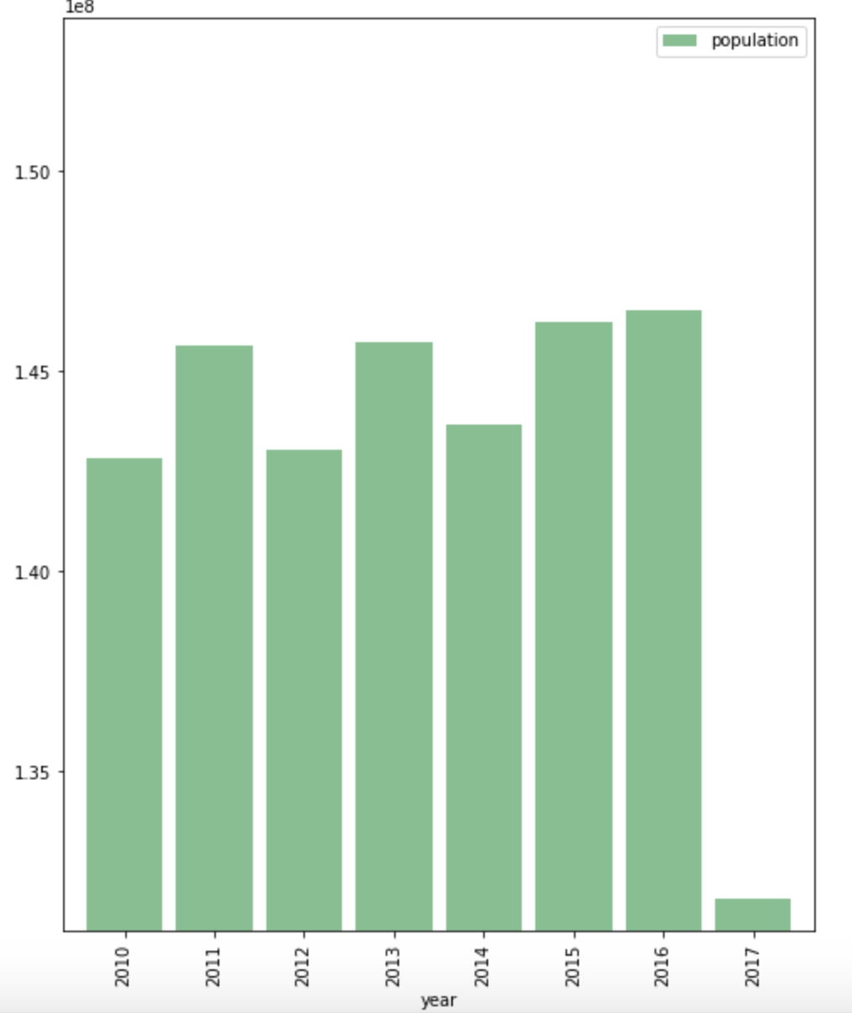
horizontal bar chart of population
population without xlimit
population with xlimit

Slide 17
Trending based on npg

Slide 18
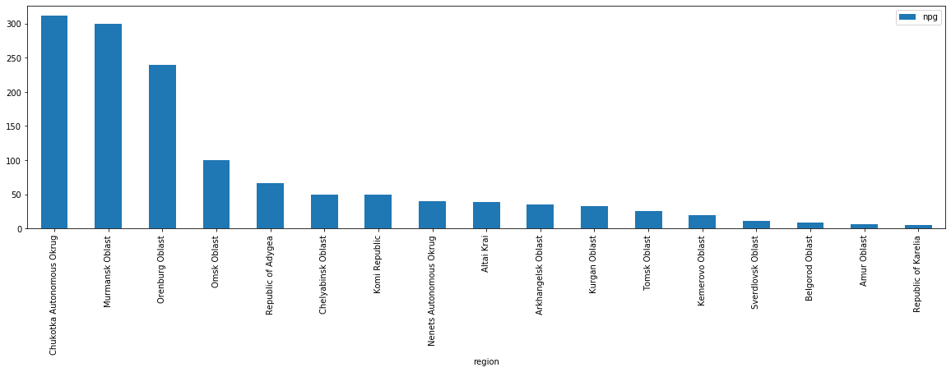
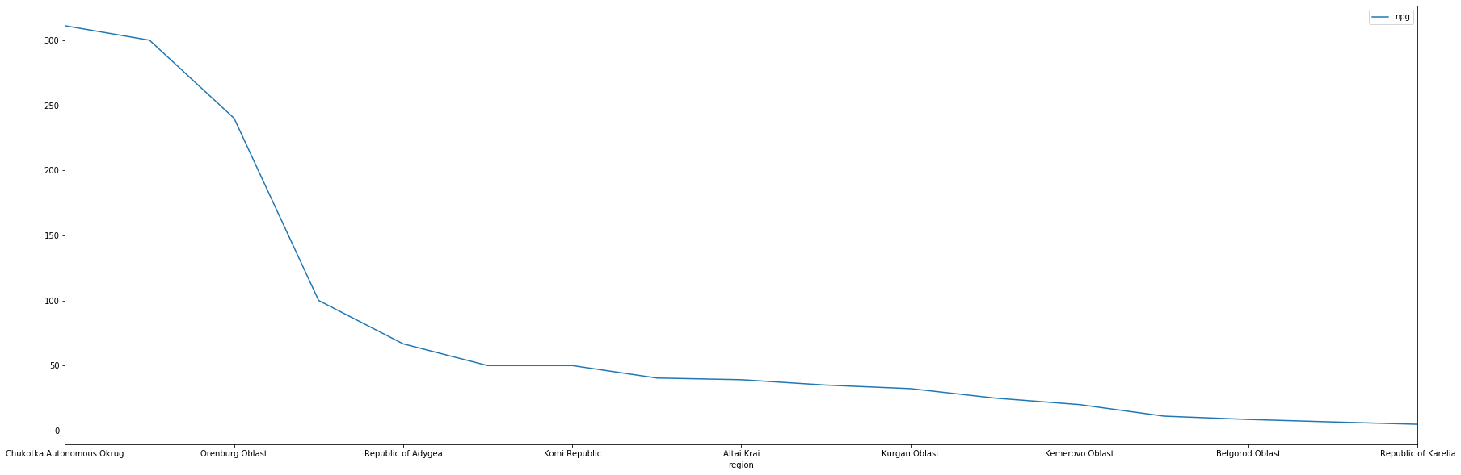
Positive trending

Slide 19
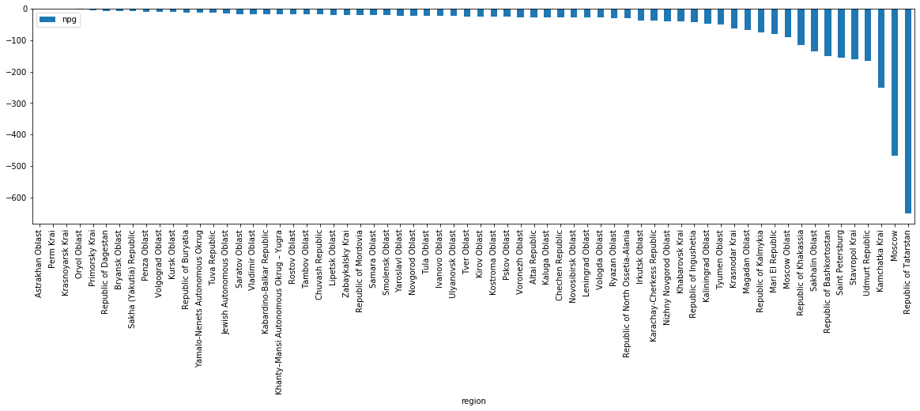
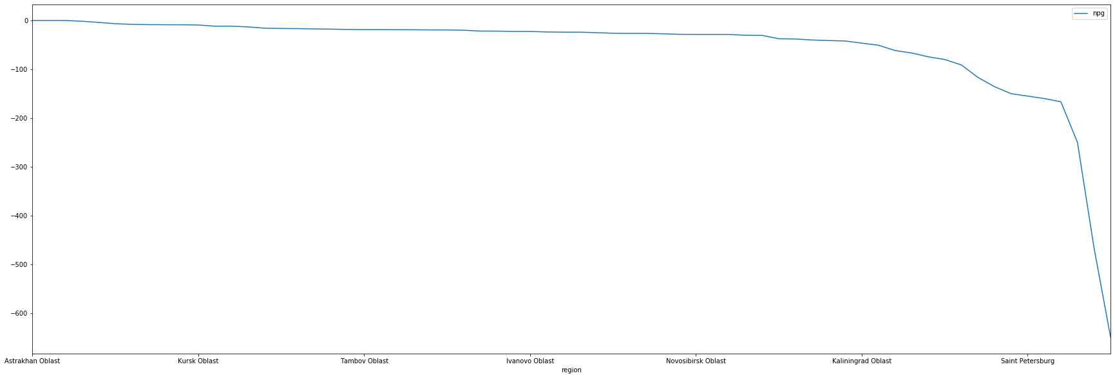
Negative trending

Slide 20
In conclusion
Based on reviewing Birth Rate, Death Rate (which is the natural growth rate) and migratory growth rates there are only 20% of the total regions experiencing positive growth. 80%, which would be the remaining regions are experiencing a decline in population.
Acknowledgements
ЕМИСС (UIISS) - Unified interdepartmental information and statistical system

Slide 21
THANK YOU, SPASIBO!
NO QUESTIONS PLEASE
IF YOU HAVE ANY QUESTIONS OR SUGESTIONS ASK ARCHANA

